Slide 1

to the study!

Slide 2
Let's play a game!!
Disagreement Study
Pos – DADA (Wagon to Dog)
Pos – ADAD (Dog to Wagon)
Pos – ADAD (Wagon to Dog)
Pos – DADA (Dog to Wagon)
Neg – DADA (Wagon to Dog)
Neg – ADAD (Dog to Wagon)
Neg – ADAD (Wagon to Dog)
Neg – DADA (Dog to Wagon)

Slide 3
VERSION 1

Slide 4

Clip A. Training Positive Agreement
Can you remind me, what did the first adult say?
Can you remind me, what did the second adult say?
So the first adult said, “Yes, I’m really sure that Casey wanted to be pushed down the slide!”
So the second adult said, “Yes, I’m really sure that Casey wanted to be pushed down the slide!”

Slide 5
Clip B. Training Positive Agreement

Slide 6
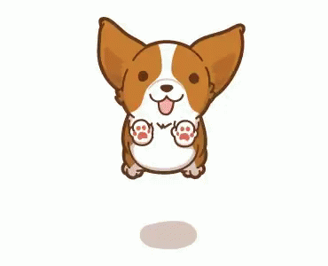
That was practice. We will play the official guessing game four times altogether. Let’s do the first one!

Slide 7
Clip A. Wagon Positive Disagreement
So the second adult said, “No, I’m really sure that Sam did not want Robin to paint the wagon orange!”
So the first adult said, “Yes, I’m really sure that Sam wanted Robin to paint the wagon orange!”
Can you remind me, what did the second adult say?
Can you remind me, what did the first adult say?

Slide 8
Clip B. Wagon Positive Disagreement

Slide 9
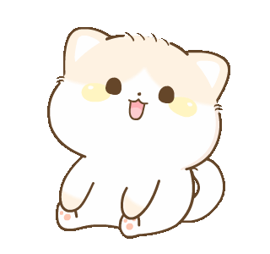
Okay, three more to go! Let’s do the next one.

Slide 10
Clip A. Tower Positive Agreement
So the second adult said, “Yes, I’m really sure that Cody wanted Morgan to finish the block tower!”
So the first adult said, “Yes, I’m really sure that Cody wanted Morgan to finish the block tower!”
Can you remind me, what did the second adult say?
Can you remind me, what did the first adult say?

Slide 11
Clip B. Tower Positive Agreement

Slide 12
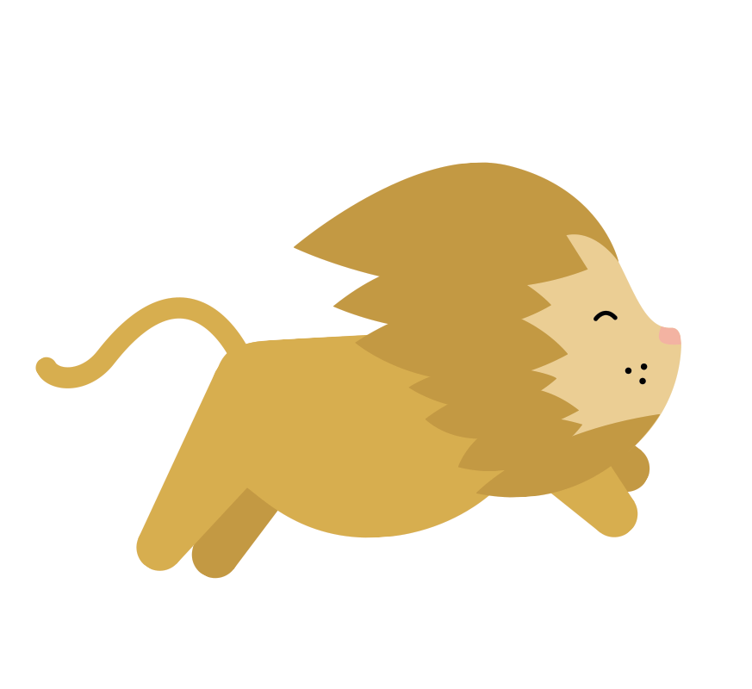
We’re halfway there! Let’s do the next one.

Slide 13
Clip A. Snowman Positive Disagreement
So the second adult said, “No, I’m really sure that Jordan did not want Avery to draw a hat on the snowman!”
So the first adult said, “Yes, I’m really sure that Jordan wanted Avery to draw the hat on the snowman!”
Can you remind me, what did the first adult say?
Can you remind me, what did the second adult say?

Slide 14
Clip B. Snowman Positive Disagreement

Slide 15
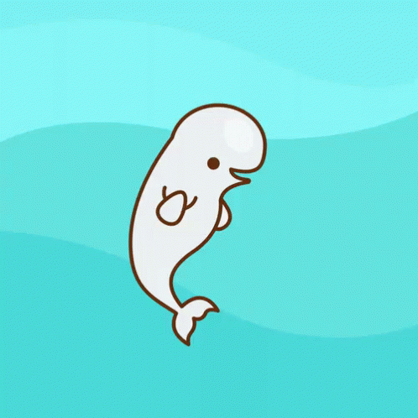
One more to go! Let’s do the last one.

Slide 16
Clip A. Dog Positive Agreement
So the second adult said, “Yes, I’m really sure that Bailey wanted Devin to feed the dog three treats!”
So the first adult said, “Yes, I’m really sure that Bailey wanted Devin to feed the dog three treats!”
Can you remind me, what did the first adult say?
Can you remind me, what did the second adult say?

Slide 17
Clip B. Dog Positive Agreement

Slide 18
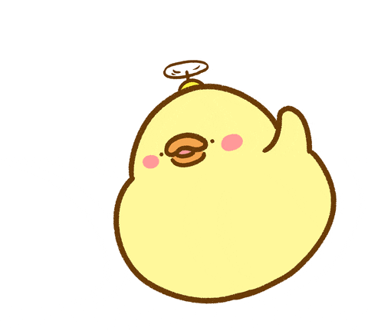
You’re all done – Thank you!

Slide 19
VERSION 2

Slide 20
Clip A. Training Positive Agreement
So the first adult said, “Yes, I’m really sure that Casey wanted to be pushed down the slide!”
So the second adult said, “Yes, I’m really sure that Casey wanted to be pushed down the slide!”
Can you remind me, what did the second adult say?
Can you remind me, what did the first adult say?

Slide 21
Clip B. Training Positive Agreement

Slide 22
That was practice. We will play the official guessing game four times altogether. Let’s do the first one!

Slide 23
Clip A. Dog Positive Agreement
So the second adult said, “Yes, I’m really sure that Bailey wanted Devin to feed the dog three treats!”
So the first adult said, “Yes, I’m really sure that Bailey wanted Devin to feed the dog three treats!”
Can you remind me, what did the first adult say?
Can you remind me, what did the second adult say?

Slide 24
Clip B. Dog Positive Agreement

Slide 25
Okay, three more to go! Let’s do the next one.

Slide 26
Clip A. Snowman Positive Disagreement
So the second adult said, “No, I’m really sure that Jordan did not want Avery to draw a hat on the snowman!”
So the first adult said, “Yes, I’m really sure that Jordan wanted Avery to draw the hat on the snowman!”
Can you remind me, what did the first adult say?
Can you remind me, what did the second adult say?

Slide 27
Clip B. Snowman Positive Disagreement

Slide 28
We’re halfway there! Let’s do the next one.

Slide 29
Clip A. Tower Positive Agreement
So the second adult said, “Yes, I’m really sure that Cody wanted Morgan to finish the block tower!”
So the first adult said, “Yes, I’m really sure that Cody wanted Morgan to finish the block tower!”
Can you remind me, what did the second adult say?
Can you remind me, what did the first adult say?

Slide 30
Clip B. Tower Positive Agreement

Slide 31
One more to go! Let’s do the last one.

Slide 32
Clip A. Wagon Positive Disagreement
So the second adult said, “No, I’m really sure that Sam did not want Robin to paint the wagon orange!”
So the first adult said, “Yes, I’m really sure that Sam wanted Robin to paint the wagon orange!”
Can you remind me, what did the second adult say?
Can you remind me, what did the first adult say?

Slide 33
Clip B. Wagon Positive Disagreement

Slide 34
You’re all done – Thank you!

Slide 35
VERSION 3

Slide 36
Clip A. Training Positive Agreement
Can you remind me, what did the first adult say?
Can you remind me, what did the second adult say?
So the first adult said, “Yes, I’m really sure that Casey wanted to be pushed down the slide!”
So the second adult said, “Yes, I’m really sure that Casey wanted to be pushed down the slide!”

Slide 37
Clip B. Training Positive Agreement

Slide 38
That was practice. We will play the official guessing game four times altogether. Let’s do the first one!

Slide 39
Clip A. Wagon Positive Agreement
So the second adult said, “Yes, I’m really sure that Sam wanted Robin to paint the wagon orange!”
So the first adult said, “Yes, I’m really sure that Sam wanted Robin to paint the wagon orange!”
Can you remind me, what did the first adult say?
Can you remind me, what did the second adult say?

Slide 40
Clip B. Wagon Positive Agreement

Slide 41
Okay, three more to go! Let’s do the next one.

Slide 42
Clip A. Tower Positive Disagreement
So the second adult said, “No, I’m really sure that Cody did not want Morgan to finish the block tower!”
So the first adult said, “Yes, I’m really sure that Cody wanted Morgan to finish the block tower!”
Can you remind me, what did the first adult say?
Can you remind me, what did the second adult say?

Slide 43
Clip B. Tower Positive Disagreement

Slide 44
We’re halfway there! Let’s do the next one.

Slide 45
Clip A. Snowman Positive Agreement
So the second adult said, “Yes, I’m really sure that Jordan wanted Avery to draw the hat on the snowman!”
So the first adult said, “Yes, I’m really sure that Jordan wanted Avery to draw the hat on the snowman!”
Can you remind me, what did the first adult say?
Can you remind me, what did the second adult say?

Slide 46
Clip B. Snowman Positive Agreement

Slide 47
One more to go! Let’s do the last one.

Slide 48
Clip A. Dog Positive Disagreement
So the second adult said, “No, I’m really sure that Bailey did not want Devin to feed the dog three treats!”
So the first adult said, “Yes, I’m really sure that Bailey wanted Devin to feed the dog three treats!”
Can you remind me, what did the first adult say?
Can you remind me, what did the second adult say?

Slide 49
Clip B. Dog Positive Disagreement

Slide 50
You’re all done – Thank you!

Slide 51
VERSION 4

Slide 52
Clip A. Training Positive Agreement
Can you remind me, what did the first adult say?
Can you remind me, what did the second adult say?
So the first adult said, “Yes, I’m really sure that Casey wanted to be pushed down the slide!”
So the second adult said, “Yes, I’m really sure that Casey wanted to be pushed down the slide!”

Slide 53
Clip B. Training Positive Agreement

Slide 54
That was practice. We will play the official guessing game four times altogether. Let’s do the first one!

Slide 55
Clip A. Dog Positive Disagreement
So the second adult said, “No, I’m really sure that Bailey did not want Devin to feed the dog three treats!”
So the first adult said, “Yes, I’m really sure that Bailey wanted Devin to feed the dog three treats!”
Can you remind me, what did the first adult say?
Can you remind me, what did the second adult say?

Slide 56
Clip B. Dog Positive Disagreement

Slide 57
Okay, three more to go! Let’s do the next one.

Slide 58
Clip A. Snowman Positive Agreement
So the second adult said, “Yes, I’m really sure that Jordan wanted Avery to draw the hat on the snowman!”
So the first adult said, “Yes, I’m really sure that Jordan wanted Avery to draw the hat on the snowman!”
Can you remind me, what did the first adult say?
Can you remind me, what did the second adult say?

Slide 59
Clip B. Snowman Positive Agreement

Slide 60
We’re halfway there! Let’s do the next one.

Slide 61
Clip A. Tower Positive Disagreement
So the second adult said, “No, I’m really sure that Cody did not want Morgan to finish the block tower!”
So the first adult said, “Yes, I’m really sure that Cody wanted Morgan to finish the block tower!”
Can you remind me, what did the first adult say?
Can you remind me, what did the second adult say?

Slide 62
Clip B. Tower Positive Disagreement

Slide 63
One more to go! Let’s do the last one.

Slide 64
Clip A. Wagon Positive Agreement
So the second adult said, “Yes, I’m really sure that Sam wanted Robin to paint the wagon orange!”
So the first adult said, “Yes, I’m really sure that Sam wanted Robin to paint the wagon orange!”
Can you remind me, what did the first adult say?
Can you remind me, what did the second adult say?

Slide 65
Clip B. Wagon Positive Agreement

Slide 66
You’re all done – Thank you!

Slide 67
VERSION 5

Slide 68
Clip A. Training Negative Agreement
So the second adult said, “No, I’m really sure that Casey did not want to be pushed down the slide!”
So the first adult said, “No, I’m really sure that Casey did not want to be pushed down the slide!”
Can you remind me, what did the second adult say?
Can you remind me, what did the first adult say?

Slide 69
Clip B. Training Negative Agreement

Slide 70
That was practice. We will play the official guessing game four times altogether. Let’s do the first one!

Slide 71
Clip A. Wagon Negative Disagreement
So the second adult said, “No, I’m really sure that Sam did not want Robin to paint the wagon orange!”
So the first adult said, “Yes, I’m really sure that Sam wanted Robin to paint the wagon orange!”
Can you remind me, what did the first adult say?
Can you remind me, what did the second adult say?

Slide 72
Clip B. Wagon Negative Disagreement

Slide 73
Okay, three more to go! Let’s do the next one.

Slide 74
Clip A. Tower Negative Agreement
So the second adult said, “No, I’m really sure that Cody did not want Morgan to finish the block tower!”
So the first adult said, “No, I’m really sure that Cody did not want Morgan to finish the block tower!”
Can you remind me, what did the first adult say?
Can you remind me, what did the second adult say?

Slide 75
Clip B. Tower Negative Agreement

Slide 76
We’re halfway there! Let’s do the next one.

Slide 77
Clip A. Snowman Negative Disagreement
So the second adult said, “No, I’m really sure that Jordan did not want Avery to draw a hat on the snowman!”
So the first adult said, “Yes, I’m really sure that Jordan wanted Avery to draw the hat on the snowman!”
Can you remind me, what did the second adult say?
Can you remind me, what did the first adult say?

Slide 78
Clip B. Snowman Negative Disagreement

Slide 79
One more to go! Let’s do the last one.

Slide 80
Clip A. Dog Negative Agreement
So the second adult said, “No, I’m really sure that Bailey did not want Devin to feed the dog three treats!”
So the first adult said, “No, I’m really sure that Bailey did not want Devin to feed the dog three treats!”
Can you remind me, what did the first adult say?
Can you remind me, what did the second adult say?

Slide 81
Clip B. Dog Negative Agreement

Slide 82
You’re all done – Thank you!

Slide 83
VERSION 6

Slide 84
Clip A. Training Negative Agreement
So the second adult said, “No, I’m really sure that Casey did not want to be pushed down the slide!”
So the first adult said, “No, I’m really sure that Casey did not want to be pushed down the slide!”
Can you remind me, what did the second adult say?
Can you remind me, what did the first adult say?

Slide 85
Clip B. Training Negative Agreement

Slide 86
That was practice. We will play the official guessing game four times altogether. Let’s do the first one!

Slide 87
Clip A. Dog Negative Agreement
So the second adult said, “No, I’m really sure that Bailey did not want Devin to feed the dog three treats!”
So the first adult said, “No, I’m really sure that Bailey did not want Devin to feed the dog three treats!”
Can you remind me, what did the first adult say?
Can you remind me, what did the second adult say?

Slide 88
Clip B. Dog Negative Agreement

Slide 89
Okay, three more to go! Let’s do the next one.

Slide 90
Clip A. Snowman Negative Disagreement
So the second adult said, “No, I’m really sure that Jordan did not want Avery to draw a hat on the snowman!”
So the first adult said, “Yes, I’m really sure that Jordan wanted Avery to draw the hat on the snowman!”
Can you remind me, what did the second adult say?
Can you remind me, what did the first adult say?

Slide 91
Clip B. Snowman Negative Disagreement

Slide 92
We’re halfway there! Let’s do the next one.

Slide 93
Clip A. Tower Negative Agreement
So the second adult said, “No, I’m really sure that Cody did not want Morgan to finish the block tower!”
So the first adult said, “No, I’m really sure that Cody did not want Morgan to finish the block tower!”
Can you remind me, what did the first adult say?
Can you remind me, what did the second adult say?

Slide 94
Clip B. Tower Negative Agreement

Slide 95
One more to go! Let’s do the last one.

Slide 96
Clip A. Wagon Negative Disagreement
So the second adult said, “No, I’m really sure that Sam did not want Robin to paint the wagon orange!”
So the first adult said, “Yes, I’m really sure that Sam wanted Robin to paint the wagon orange!”
Can you remind me, what did the first adult say?
Can you remind me, what did the second adult say?

Slide 97
Clip B. Wagon Negative Disagreement

Slide 98
You’re all done – Thank you!

Slide 99
VERSION 7

Slide 100
Clip A. Training Negative Agreement
So the second adult said, “No, I’m really sure that Casey did not want to be pushed down the slide!”
So the first adult said, “No, I’m really sure that Casey did not want to be pushed down the slide!”
Can you remind me, what did the second adult say?
Can you remind me, what did the first adult say?

Slide 101
Clip B. Training Negative Agreement

Slide 102
That was practice. We will play the official guessing game four times altogether. Let’s do the first one!

Slide 103
Clip A. Wagon Negative Agreement
So the first adult said, “No, I’m really sure that Sam did not want Robin to paint the wagon orange!”
Can you remind me, what did the first adult say?
Can you remind me, what did the second adult say?
So the second adult said, “No, I’m really sure that Sam did not want Robin to paint the wagon orange!”

Slide 104
Clip B. Wagon Negative Agreement

Slide 105
Okay, three more to go! Let’s do the next one.

Slide 106
Clip A. Tower Negative Disagreement
So the second adult said, “No, I’m really sure that Cody did not want Morgan to finish the block tower!”
So the first adult said, “Yes, I’m really sure that Cody wanted Morgan to finish the block tower!”
Can you remind me, what did the first adult say?
Can you remind me, what did the second adult say?

Slide 107
Clip B. Tower Negative Disagreement

Slide 108
We’re halfway there! Let’s do the next one.

Slide 109
Clip A. Snowman Negative Agreement
So the second adult said, “No, I’m really sure that Jordan did not want Avery to draw the hat on the snowman!”
So the first adult said, “No, I’m really sure that Jordan did not want Avery to draw the hat on the snowman!”
Can you remind me, what did the second adult say?
Can you remind me, what did the first adult say?

Slide 110
Clip B. Snowman Negative Agreement

Slide 111
One more to go! Let’s do the last one.

Slide 112
Clip A. Dog Negative Disagreement
So the second adult said, “No, I’m really sure that Bailey did not want Devin to feed the dog three treats!”
So the first adult said, “Yes, I’m really sure that Bailey wanted Devin to feed the dog three treats!”
Can you remind me, what did the first adult say?
Can you remind me, what did the second adult say?

Slide 113
Clip B. Dog Negative Disagreement

Slide 114
You’re all done – Thank you!

Slide 115
VERSION 8

Slide 116
Clip A. Training Negative Agreement
So the second adult said, “No, I’m really sure that Casey did not want to be pushed down the slide!”
So the first adult said, “No, I’m really sure that Casey did not want to be pushed down the slide!”
Can you remind me, what did the second adult say?
Can you remind me, what did the first adult say?

Slide 117
Clip B. Training Negative Agreement

Slide 118
That was practice. We will play the official guessing game four times altogether. Let’s do the first one!

Slide 119
Clip A. Dog Negative Disagreement
So the second adult said, “No, I’m really sure that Bailey did not want Devin to feed the dog three treats!”
So the first adult said, “Yes, I’m really sure that Bailey wanted Devin to feed the dog three treats!”
Can you remind me, what did the first adult say?
Can you remind me, what did the second adult say?

Slide 120
Clip B. Dog Negative Disagreement

Slide 121
Okay, three more to go! Let’s do the next one.

Slide 122
Clip A. Snowman Negative Agreement
So the second adult said, “No, I’m really sure that Jordan did not want Avery to draw the hat on the snowman!”
So the first adult said, “No, I’m really sure that Jordan did not want Avery to draw the hat on the snowman!”
Can you remind me, what did the second adult say?
Can you remind me, what did the first adult say?

Slide 123
Clip B. Snowman Negative Agreement

Slide 124
We’re halfway there! Let’s do the next one.

Slide 125
Clip A. Tower Negative Disagreement
So the second adult said, “No, I’m really sure that Cody did not want Morgan to finish the block tower!”
So the first adult said, “Yes, I’m really sure that Cody wanted Morgan to finish the block tower!”
Can you remind me, what did the first adult say?
Can you remind me, what did the second adult say?

Slide 126
Clip B. Tower Negative Disagreement

Slide 127
One more to go! Let’s do the last one.

Slide 128
Clip A. Wagon Negative Agreement
So the first adult said, “No, I’m really sure that Sam did not want Robin to paint the wagon orange!”
Can you remind me, what did the first adult say?
Can you remind me, what did the second adult say?
So the second adult said, “No, I’m really sure that Sam did not want Robin to paint the wagon orange!”

Slide 129
Clip B. Wagon Negative Agreement

Slide 130
You’re all done – Thank you!

